Slide 1


MOVIES HUB
PRESENTED BY:
ANSHIL MANIYA
MIRIL KIKANI
PAL MUKESH
DHRUVI KARANAVAT
GROUP NO. 11
Guided by: prof. Nidhi Desai

Slide 2
INTRODUCTION
Movies Hub is a user-friendly online streaming service offering a diverse collection of movies from various genres, languages, and regions. Our mission is to provide seamless access to quality entertainment for movie lovers around the world.
We believe that movies have the power to entertain, inspire, and bring people together. Our vision is to create an immersive and personalized viewing experience, making movies accessible to everyone, anytime, and anywhere.
Whether you’re a fan of action-packed blockbusters, heartwarming romances, gripping thrillers, or indie films, we’ve curated a library to suit every taste and mood.

Slide 3
FEATURES AND BENEFITS
User-friendly Interface
Vast Library
Multi-device Compatibility
Offline Viewing
Affordable Pricing

Slide 4
TECHNOLOGY USED
React js
HTMl
CSS
Java Script

Slide 5
DATA FLOW DIAGRAM
Home
Get Started
Sign up/Sign in
Register
Language
Release
Watch/Download
Contact Us
Categories

Slide 6
MODULES OF PROJECT
Registration / Login
Search Movies
Online / Offline Watching
Terms and use
About

Slide 7
ADMIN
Registration (Login)
Managing User
Managing Categories
Managing issues
Managing New-Release Movies
View Collections
Manage page

Slide 8
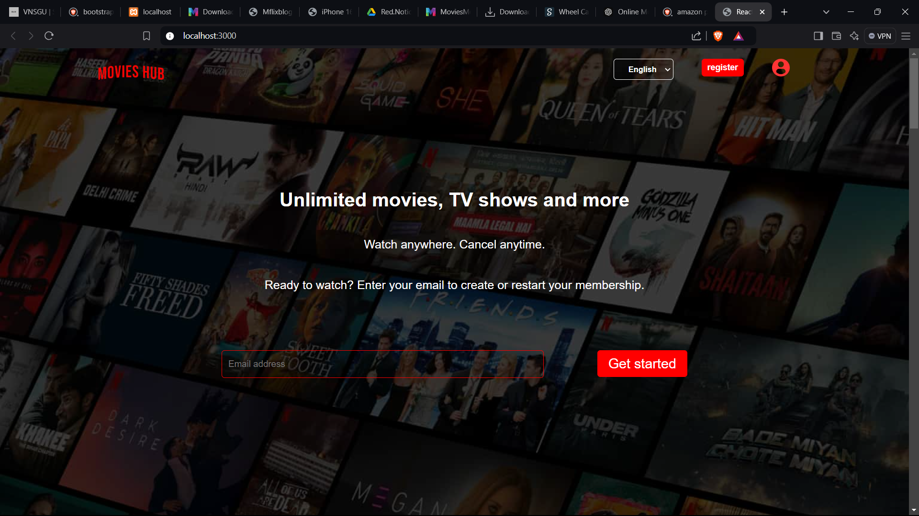
Home Page

Slide 9
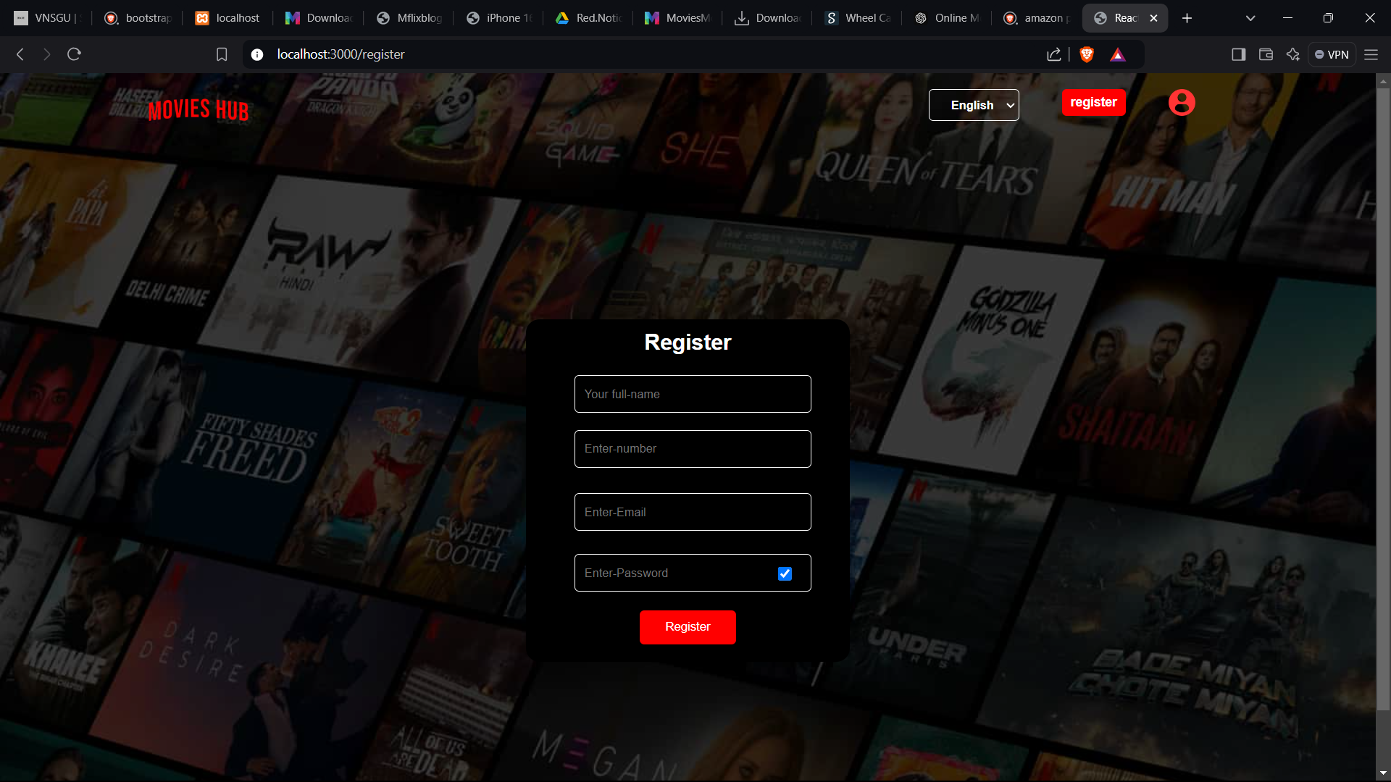
User Registration

Slide 10
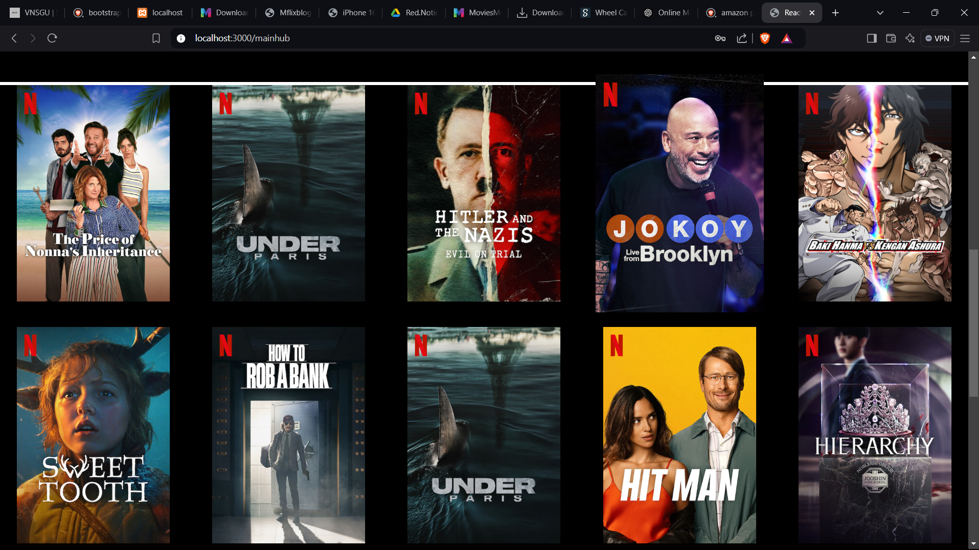
Movie Collection

Slide 11
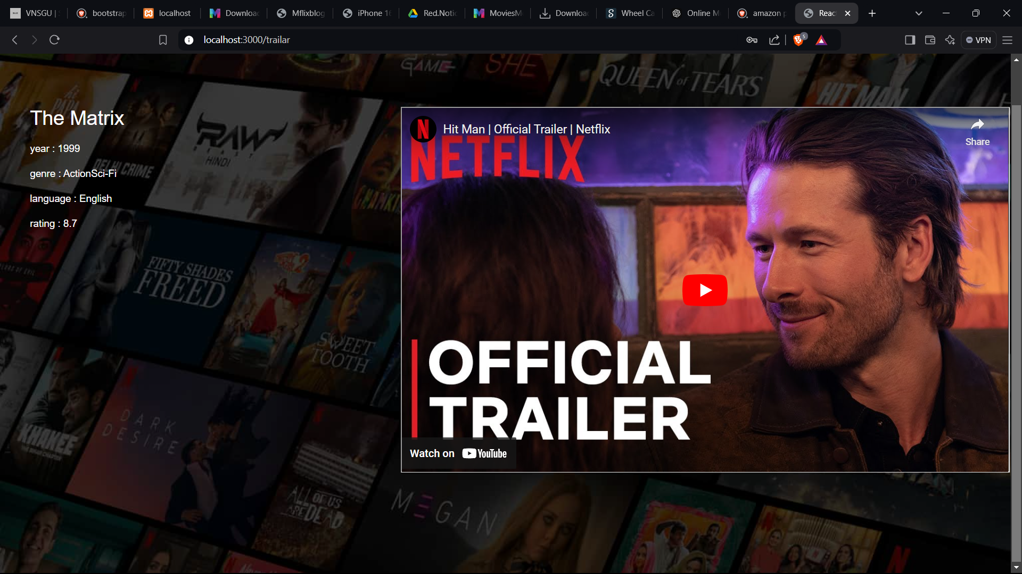
Watch

Slide 12

CONCLUSION
As the entertainment landscape continues to shift toward on-demand content, Movies Hub is positioned to be at the forefront of this revolution. Our platform combines a vast library of movies, a seamless user experience, and cutting-edge technology to bring high-quality entertainment right to the viewer’s fingertips. Whether it's a blockbuster hit or a hidden gem, Movies Hub offers a personalized and accessible movie-watching experience for everyone.

Slide 13
REFERENCES
https://www.netflix.com/in/
https://www.hotstar.com/in\
https://www.primevideo.com/
(13) thapa technical html css website – YouTube
https://youtu.be/-mJFZp84TIY?si=xN1woljmpsKStv0B
https://youtu.be/ajdRvxDWH4w?si=Xeswtns2DJDMdPyX
https://getbootstrap.com/

Slide 14

THANK YOU!!

